Slide 1
Skill Enhancement Course (SEC)
T1
Logic and Sets
Prepared by:
Dr. Rima Barik
On 01/09/2023
Department of Mathematics
Khatra Adibasi Mahavidyalaya

Slide 2
UNIT 1
Mathematical Logic
Topics to be introduced here:
Propositional Logic
Connectives
Negations
Logical Equivalences

Slide 3
Proposition
Definition:
A declarative sentence which is either true or false, but not both at the same time, is called a Proposition or Statement.
Example:
Kolkata is the capital of India.
3 + 4 = 7.
Who is your father ?

Slide 4
Proposition contd.
Truth Value
A proposition is always either true or false; the truthness or falsity of a proposition is called its Truth Value.
Propositional variables
A proposition is denoted by small letters like p,q,r,s,t,............ They are known as Propositional variables.

Slide 5
Proposition contd.
Types of Propositions
Simple Proposition-cannot be broken into two or more simpler propositions
Compound Proposition-can be further decomposed into two or more simple propositions

Slide 6
Truth Table
When truth values of a compound proposition are written in a tabular form, along with the truth values of its constituent simple propositions, it is called the truth table of the compound proposition.

Slide 7
Proposition contd.
Connectives:
The phrase which are used for joining two or more simple propositions together to form one compound statement, are called Connectives.
Example:
1) Ram and Shyam will go to the school
2) Either me or my brother will go to the party
3) I will not go to school if it rains tomorrow

Slide 8
Types of Connectives:
Negation
Disjunction
Conjunction
Conditional
Biconditional

Slide 9
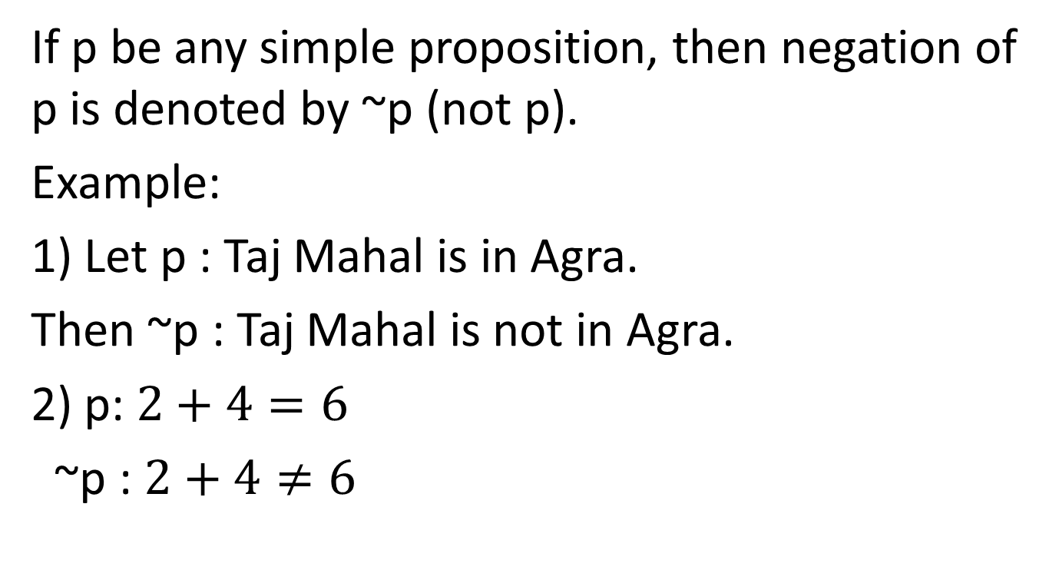
Negation
If p be any simple proposition, then negation of p is denoted by ~p (not p).
Example:
1) Let p : Taj Mahal is in Agra.
Then ~p : Taj Mahal is not in Agra.
2) p: $2+4=6$
~p : $2+4≠6$

Slide 10
Negation contd.
p and ~p will always have opposite truth values of each other.
The Truth Table is as follows:
p | ~p
T | F
F | T

Slide 11
Disjunction
If p and q be any two simple propositions, then disjunction of p and q is denoted by p V q (p or q).
Example:
Let p : Today is Sunday ; q : Today is Monday
Then p V q : Today is either Sunday or Monday.

Slide 12
Disjunction cotnd.
P V q is True if any one of it is True or both are Truth.
It is False only when both are False.
The truth table is as follows:
p | q | pVq
T | T | T
T | F | T
F | T | T
F | F | F

Slide 13
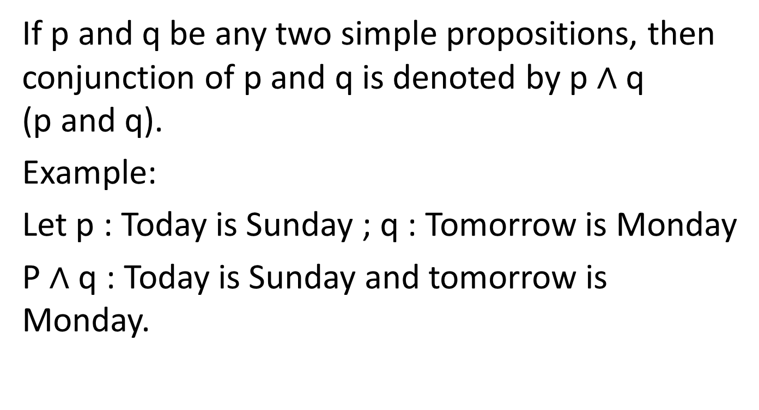
Conjunction
If p and q be any two simple propositions, then conjunction of p and q is denoted by p $∧$q (p and q).
Example:
Let p : Today is Sunday ; q : Tomorrow is Monday
P $∧$q : Today is Sunday and tomorrow is Monday.

Slide 14
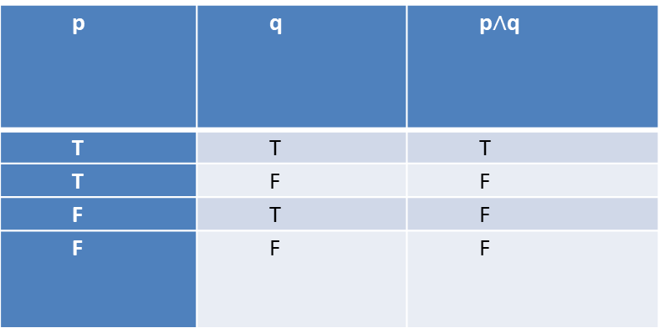

Conjunction cotnd.
p $∧$ q is True if both p and q are True.
It is False when any one of p or q is False.
The truth table is as follows :
p | q | p$∧$q
T | T | T
T | F | F
F | T | F
F | F | F

Slide 15
Conditional
Let p and q be two simple propositions, then if p then q, is called a conditional proposition and it is denoted by p→q.
Example:
p : 2 is a factor of 26
q : 26 is an even number
p→q : if 2 is a factor of 26 then 26 is an even number.

Slide 16
Conditional cotnd.
A conditional statement is False only when the first statement is true but the second one is not.
The truth table is:
p | q | p→q
T | T | T
T | F | F
F | T | T
F | F | T

Slide 17
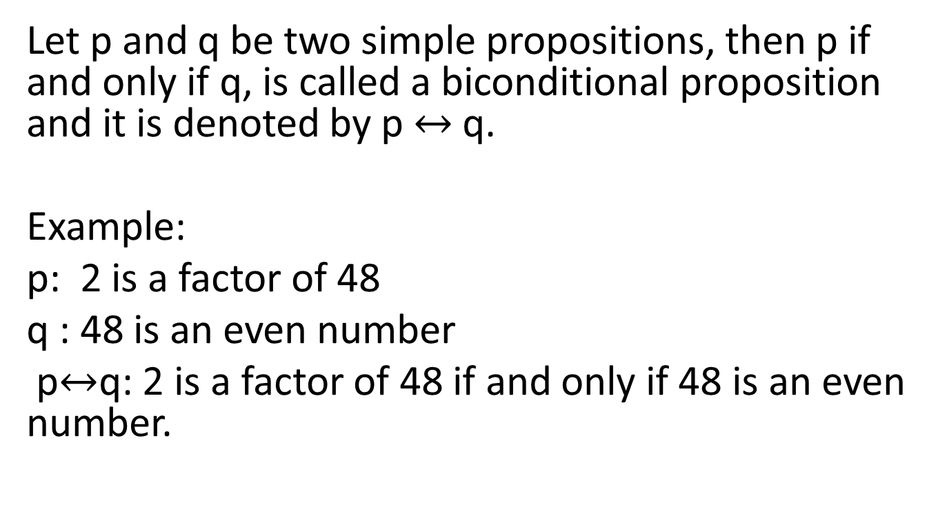
Biconditional
Let p and q be two simple propositions, then p if and only if q, is called a biconditional proposition and it is denoted by p $↔$q.
Example:
p: 2 is a factor of 48
q : 48 is an even number
p$↔$q: 2 is a factor of 48 if and only if 48 is an even number.

Slide 18
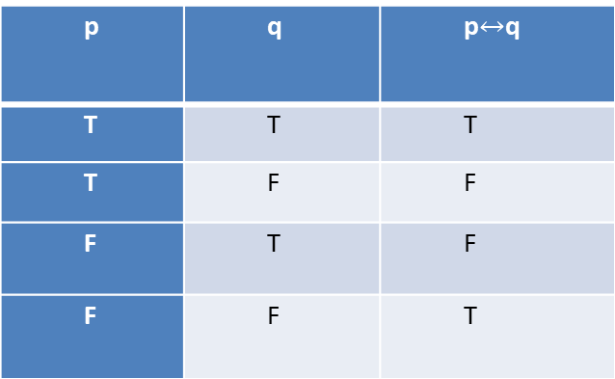
Biconditional cotnd.
A biconditional statement is False only when the two component statements have different truth values.
The Truth Table is:
p | q | p$↔$q
T | T | T
T | F | F
F | T | F
F | F | T

Slide 19
Tautology:
A proposition is called tautology if its truth value is always “T”, for any possible combination of truth values of its constituent simple propositions.
Contradiction:
A proposition is called contradiction if its truth value is always “F”, for any possible combination of truth values of its constituent simple propositions.

Slide 20
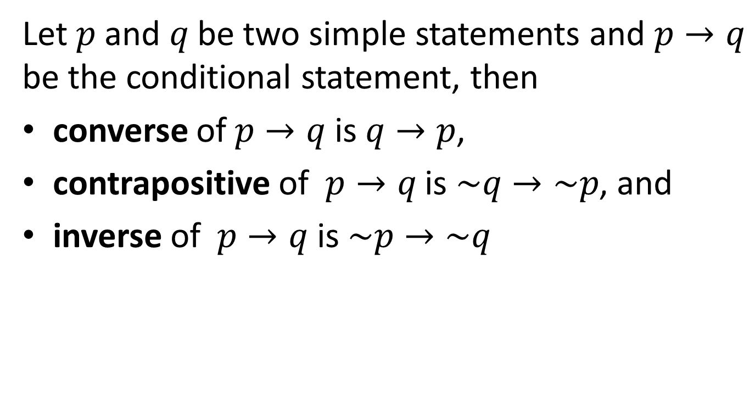
Converse, Contrapositive & Inverse
Let $p$ and $q$ be two simple statements and $p→q$ be the conditional statement, then
converse of $p→q$ is $q→p$,
contrapositive of $p→q$ is $\sim q→\sim p$, and
inverse of $p→q$ is $\sim p→\sim q$

Slide 21
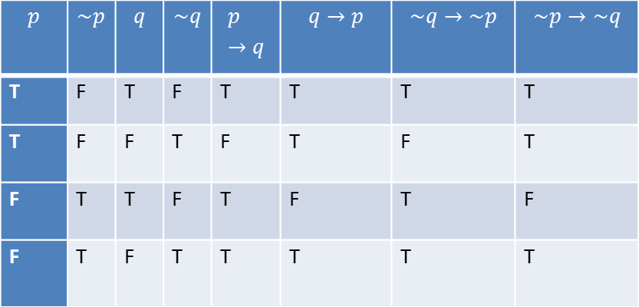
Converse, Contrapositive & Inverse contd.
$$p$$ | $$\sim p$$ | $$q$$ | $$\sim q$$ | $$p→q$$ | $$q→p$$ | $$\sim q→\sim p$$ | $$\sim p→\sim q$$
T | F | T | F | T | T | T | T
T | F | F | T | F | T | F | T
F | T | T | F | T | F | T | F
F | T | F | T | T | T | T | T

Slide 22
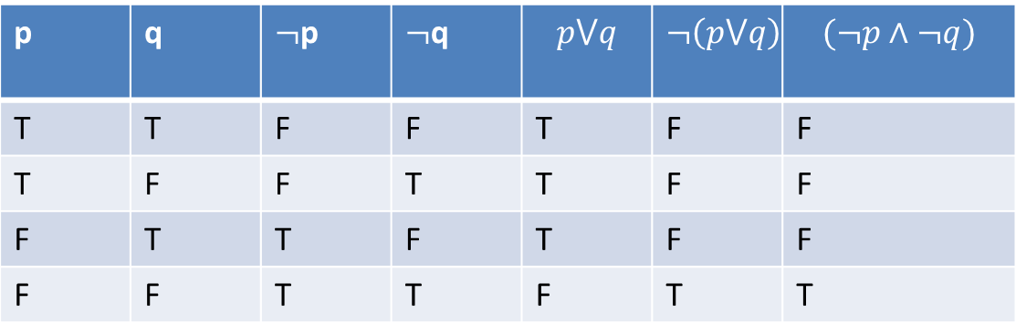
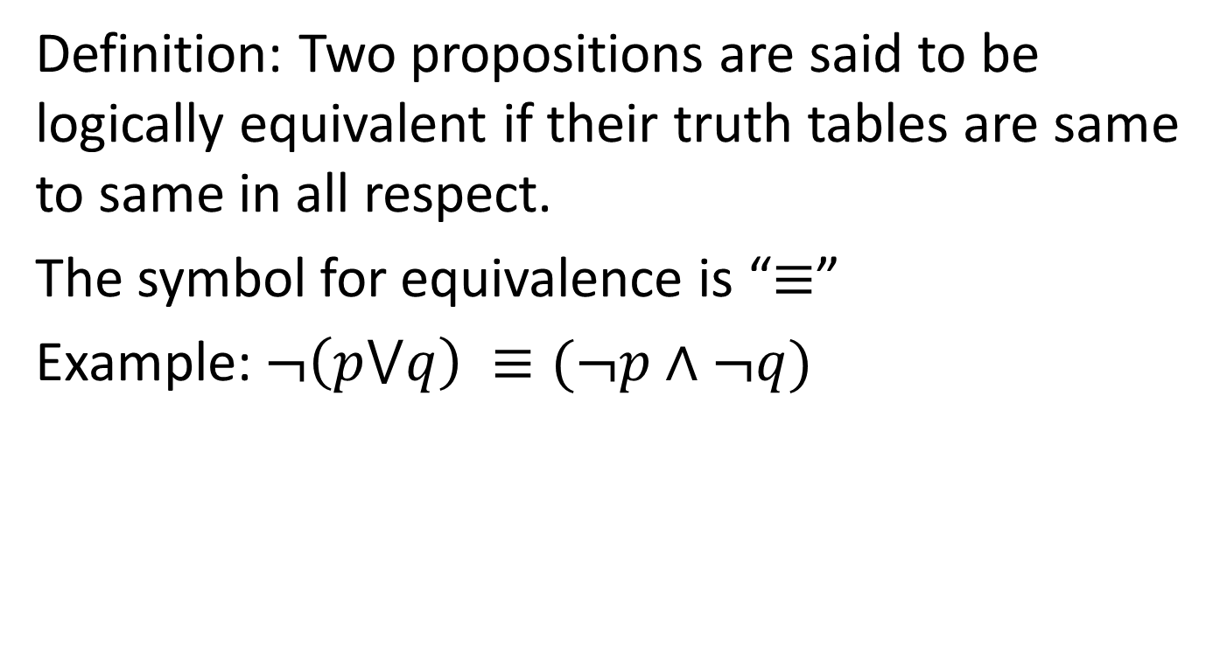
Logical Equivalence
Definition: Two propositions are said to be logically equivalent if their truth tables are same to same in all respect.
The symbol for equivalence is “$≡$”
Example: $¬\left(p⋁q\right) ≡(¬p∧¬q)$
p | q | $¬$p | $¬$q | $$p⋁q$$ | $$¬\left(p⋁q\right)$$ | $$(¬p∧¬q)$$
T | T | F | F | T | F | F
T | F | F | T | T | F | F
F | T | T | F | T | F | F
F | F | T | T | F | T | T

